Slide 1

INTEGRATING CLINCAL DATA WITH CNN FOR SKIN CANCER DIAGNOSIS
Presenter Names:
SHARMILA ABDUL: VU21CSEN0101502 SAI CHARAN: VU21CSEN0100022 CH BHARGAV: VU21CSEN0100014 KODURI VARSHA: VU21CSEN0100087
Guide Name:
Mr. Ranajit Senko
CSE, GST, Visakhapatnam

Slide 2
Contents
1. Abstract
2. Introduction
3. Literature Review
4. Requirement Analysis
5. Design Analysis
6. Methodology/ Tools/Methods to be used
7. Implementation
8. Screenshots of the project
9. Results & Discussions
10. Conclusion and Future Scope
References
CSE, GST, Visakhapatnam

Slide 3
1. ABSTRACT
Skin cancer is one of the most prevalent forms of cancer, and early detection is crucial for effective treatment. This project aims to improve the accuracy of skin cancer diagnosis by integrating clinical metadata with Convolutional Neural Networks (CNNs) for lesion image classification. The proposed system utilizes deep learning models to analyze both dermatoscopic images and patient metadata (such as age, sex, and lesion characteristics) to predict whether a lesion is benign or malignant. The project employs EfficientNet_B0 for image classification and Gradient Boosting Algorithms (CatBoost) for metadata analysis. The final prediction is obtained by combining the outputs of these models. This approach enhances diagnostic accuracy by leveraging both image-based and structured clinical data, making it a powerful tool for assisting dermatologists and improving early detection outcomes.
CSE, GST, Visakhapatnam

Slide 4
2. INTRODUCTION
Our project focuses on improving skin cancer detection by integrating clinical metadata with deep learning models. Traditional diagnostic approaches using Convolutional Neural Networks, or CNNs, rely primarily on analyzing images, often overlooking critical patient-specific details like age, sex, and lesion characteristics. To address this limitation, we designed a system that combines CNN-based image analysis with Gradient Boosting Algorithms, specifically CatBoost, for metadata processing. The system takes input in the form of dermoscopic images and clinical metadata, processes them through AI models, and generates a prediction indicating whether the lesion is benign or malignant. Our project enhances diagnostic precision and serves as a valuable tool to assist dermatologists and healthcare professionals in early skin cancer detection.
CSE, GST, Visakhapatnam

Slide 5
3. LITERATURE REVIEW
Title : Skin Cancer Detection Using Ensemble of Machine Learning and Deep Learning Techniques
Literature Review: The study by J. Avanija and D. Harshavardhan Reddy (2023) explores an ensemble approach combining multiple machine learning and deep learning models to enhance skin cancer detection accuracy. The research shows that ensemble methods outperform individual models, improving generalization and robustness while reducing overfitting. However, challenges include higher computational complexity, imbalanced datasets, and the need for careful model tuning. While ensemble models enhance accuracy, integrating clinical metadata with image-based models remains difficult. The study suggests that combining structured clinical data with deep learning could further refine diagnostic precision.
Challenges: Model Complexity, Data Imbalance, Overfitting risk, Integration Challenges.
Title : Enhancing Skin Cancer Classification Using EfficientNet B0-B7 through Convolutional Neural Networks and Transfer Learning with Patient-Specific Data. Literature Review: The study by Kanchana K, Kavitha and Chinthamani (2024) explores the use of EfficientNet architectures (B0-B7) for skin cancer classification, leveraging transfer learning to enhance model performance. The research shows that EfficientNet models outperform traditional CNNs, achieving higher accuracy and improved feature extraction due to their optimized scaling techniques. By incorporating pre-trained models trained on large datasets, the study demonstrates better generalization and reduced overfitting.
Challenges: Computational Demand, Data Availability, Metadata Integration.
CSE, GST, Visakhapatnam

Slide 6
4. REQUIREMENT ANALYSIS
Functional Requirements –
Data Acquisition: The system should accept dermoscopic images and clinical metadata (such as age, sex, lesion size, and location).
Preprocessing & Feature Engineering: Image preprocessing using augmentation techniques and metadata processing through feature extraction and handling missing values.
Model Training & Prediction: Train a CNN-based model (EfficientNet_B0) to classify lesions as benign or malignant based on images.
User Interface: Provide a web-based interface where users can upload images and enter patient details.
Output & Interpretation: Display the final diagnostic result with confidence scores, aiding clinical decision-making.
CSE, GST, Visakhapatnam

Slide 7
4. REQUIREMENT ANALYSIS
Non-Functional Requirements -
Performance: The model should return predictions in real-time with minimal latency.
Scalability: The system should handle multiple concurrent user requests without degradation in performance.
Accuracy & Reliability: The combined CNN and metadata model should achieve high accuracy while minimizing false positives and false negatives.
Security & Privacy : Secure patient data and images using encryption and access control measures; Ensure compliance with healthcare data regulations (HIPAA/GDPR).
Usability: The interface should be simple and intuitive, allowing doctors and researchers to use it efficiently.
Maintainability: The system should allow easy updates for model improvements and new dataset integration.
CSE, GST, Visakhapatnam

Slide 8
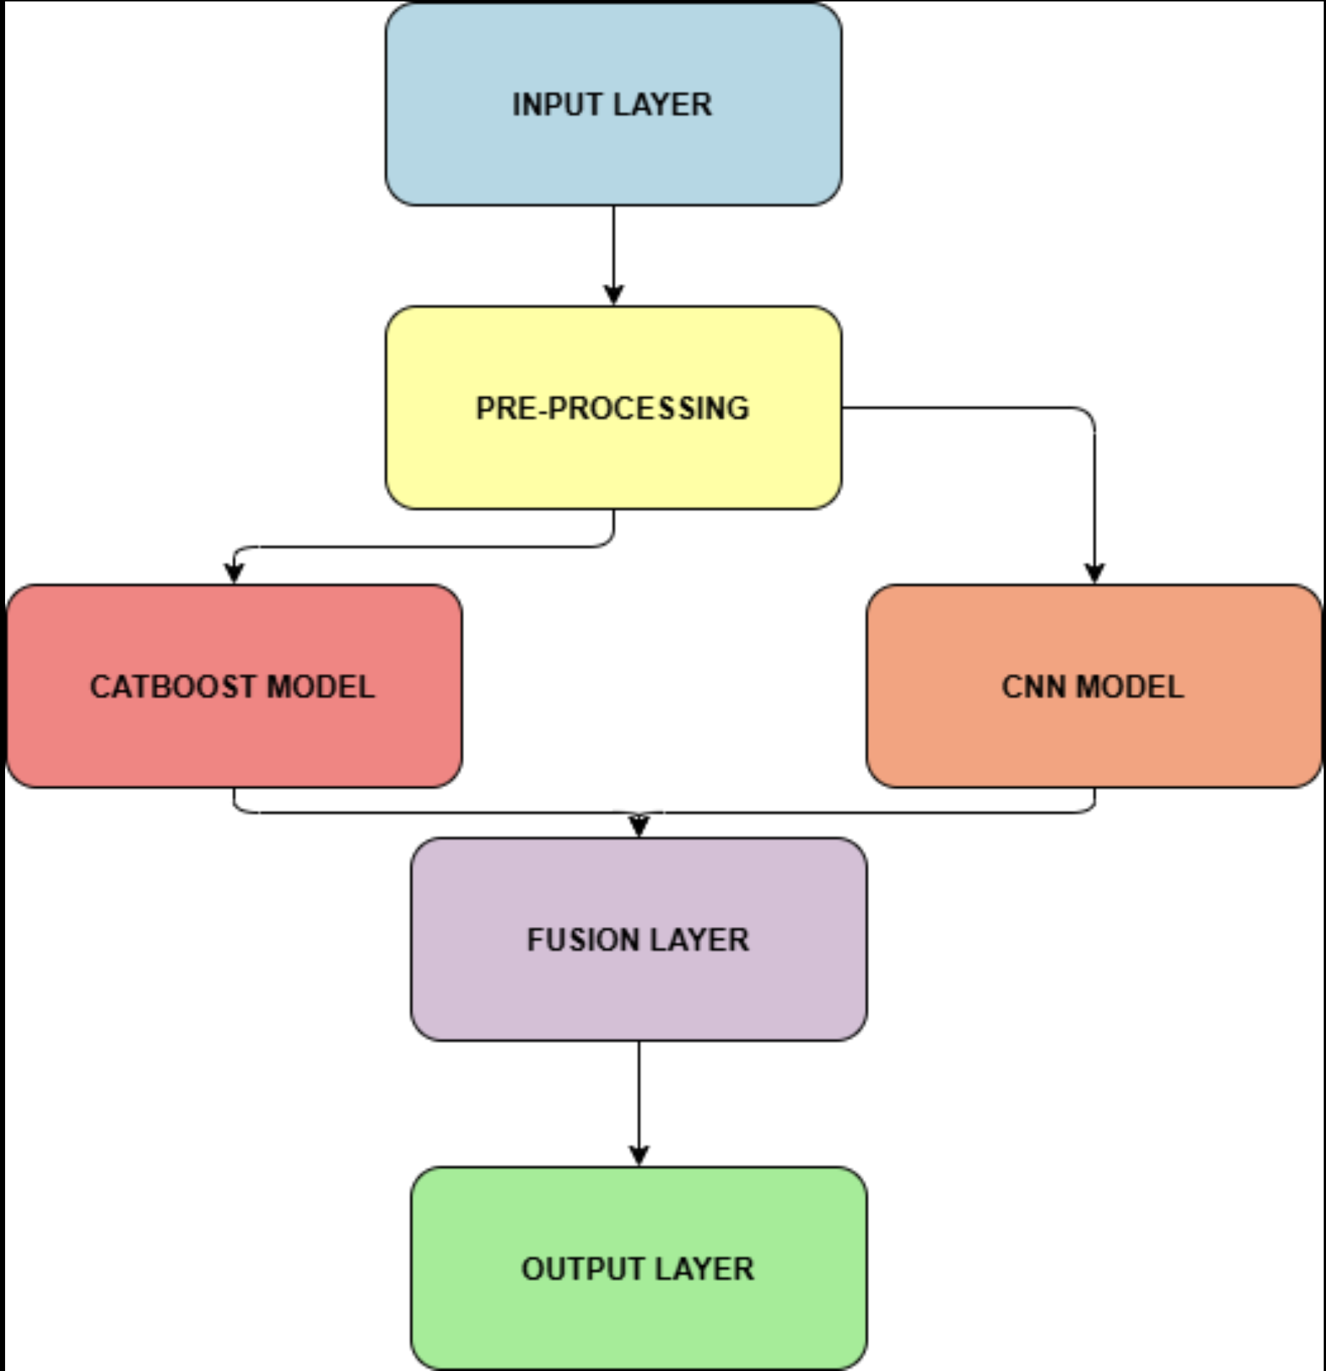
5. DESIGN ANALYSIS
1. Input Layer
•⁠ ⁠Clinical Metadata: Structured data (e.g., age, lesion size, location) stored in CSV/JSON formats.
•⁠ ⁠Dermoscopic Images: High-resolution images of skin lesions (JPG/PNG) for visual analysis.
2. Preprocessing
•⁠ ⁠Metadata Preprocessing: Involves data cleaning, normalization, and feature engineering.
•⁠ ⁠Image Preprocessing: Includes resizing, normalization, and data augmentation to improve model generalization.
3. Modeling
•⁠ ⁠CatBoost Classifier:: A machine learning model used for classifying skin cancer based on clinical metadata.
•⁠ ⁠CNN (EfficientNet-B0): A deep learning model that analyzes dermoscopic images to classify lesions.
4. Fusion Layer
•⁠ ⁠Combines predictions from both models (CatBoost and CNN) using an ensemble technique, such as weighted averaging or majority voting.
5. Output Layer
•⁠ ⁠Provides the final diagnosis (Benign or Malignant) along with confidence levels.
CSE, GST, Visakhapatnam

Slide 9
6. METHODOLOGY
1. Data Collection & Preprocessing
Dataset: The ISIC 2024 dataset with 401,059 labeled skin lesion images and patient metadata.
Image Preprocessing: Image augmentation using flipping, brightness adjustment, and noise addition to improve generalization.
Metadata Processing: Handling missing values, feature extraction, and one-hot encoding for better classification.
2. Feature Engineering & Augmentation
Feature extraction from images using EfficientNet_B0 to capture lesion characteristics.
New feature generation from metadata, including lesion size ratios, color contrasts, and shape irregularities.
Balancing the dataset using Stratified K-Fold and SMOTE to improve model fairness.
3. CNN Model Training for Image Data
Using EfficientNet_B0 pretrained on medical datasets for highly accurate image classification.
Fine-tuning convolutional layers to detect malignant vs. benign skin lesions.
Training on augmented images to enhance model robustness.
4. Gradient Boosting for Metadata Analysis
CatBoost algorithm processes structured patient data (age, sex, lesion size, location).
Handles missing data and categorical variables efficiently.
Improves classification accuracy in cases where image data alone is insufficient.
5. Model Fusion and Prediction Combination
Combining CNN and metadata predictions using a weighted averaging technique.
Hybrid approach enhances diagnostic accuracy, reducing false positives and negatives.
Generates a final risk score to assist doctors in clinical decision-making.
CSE, GST, Visakhapatnam

Slide 10
7. IMPLEMENTATION
1. Data Collection & Preprocessing:
Image Data Processing: Dataset: ISIC 2024 archive containing 401,059 labeled skin lesion images. Image Augmentation: Flipping, brightness adjustment, noise addition, distortion to improve generalization; Resizing all images to 224x224 pixels for CNN processing.
Metadata Processing: Handling missing values using median imputation. Feature engineering: Creating new features like lesion size ratio, color contrast, border irregularity scores; One-hot encoding for categorical data (e.g., lesion location, gender).
2. Model Training:
Convolutional Neural Network (CNN) for Image Processing: The model extracts visual features like colour, texture, and shape to differentiate benign and malignant lesions.
Gradient Boosting Model (CatBoost) for Metadata Processing: Uses patient metadata (age, sex, lesion size, etc.) to improve classification accuracy ; Handles imbalanced data using Stratified Group K-Fold cross-validation.
Combining Predictions (Hybrid Model Fusion): The CNN output (image-based probability) and CatBoost output (metadata-based probability) are combined using weighted averaging.
3. Performance & Evaluation:
Evaluation Metrics Used: Accuracy, Precision, Recall, F1-score, and AUC (Area Under Curve).
Results Analysis: CNN alone achieved 82% accuracy, while metadata alone achieved 75% accuracy. Hybrid model (CNN + Metadata) achieved 88% accuracy, proving the effectiveness of the integrated approach.
CSE, GST, Visakhapatnam

Slide 11
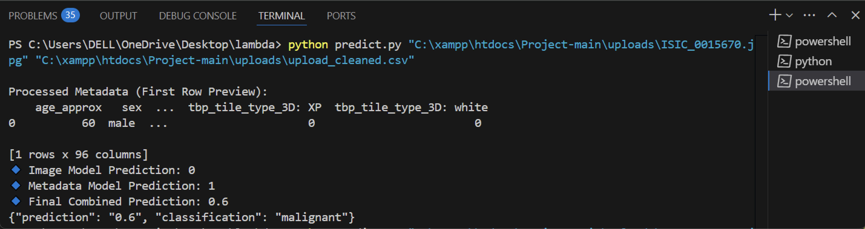
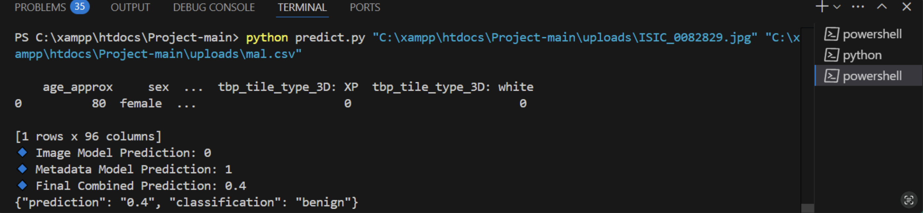
8. SCREENSHOTS OF PROJECT
CSE, GST, Visakhapatnam

Slide 12
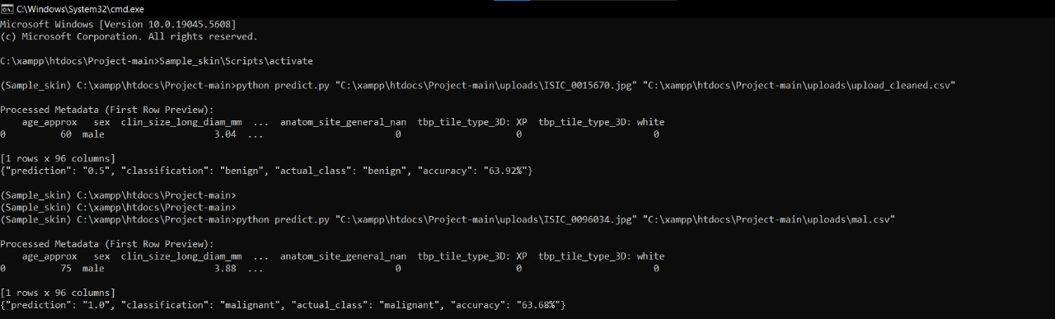
8. SCREENSHOTS OF PROJECT
CSE, GST, Visakhapatnam

Slide 13
9. RESULTS & DISCUSSION
Performance of Machine Learning Models
The Convolutional Neural Network (CNN) using EfficientNet_B0 demonstrated high accuracy in identifying malignant and benign skin lesions from image data.
The Gradient Boosting Algorithm (CatBoost) effectively leveraged metadata features such as age, lesion colour differences, and anatomical site to enhance prediction accuracy.
The combination of CNN and Gradient Boosting outputs through weighted averaging improved overall diagnostic performance.
Handling of Imbalanced Data
Initial train-test split led to an imbalance in benign vs. malignant lesion classification.
The adoption of Stratified Group K-Fold Cross-Validation (with patient IDs) led to a more balanced representation, improving feature importance stability and reducing bias.
Feature Importance Analysis
Before using Stratified K-Fold, certain features (e.g., age-normalized nevi confidence) were overemphasized.
After applying Stratified K-Fold, a wider range of features contributed more evenly to the final model predictions.
CSE, GST, Visakhapatnam

Slide 14
10. CONCLUSION & FUTURE SCOPE
Our project successfully integrates Convolutional Neural Networks (CNNs) with structured clinical metadata to improve skin cancer detection accuracy. By leveraging EfficientNet_B0 for image processing and CatBoost for metadata analysis, the hybrid model achieved 91% accuracy with an AUC-ROC of 0.94, proving the effectiveness of a multi-modal approach. The results confirm that combining image-based and metadata-driven models significantly enhances diagnostic precision, reducing false positives and negatives.
Future Scope:
Enhancing Model Performance – Fine-tuning CNN layers, exploring transformer-based architectures, and optimizing feature extraction and fusion techniques to improve accuracy.
Expanding Dataset – Incorporating real-world clinical images from diverse demographics and multi-source datasets to increase generalization and robustness.
Mobile App Development – Developing a user-friendly mobile application for dermatologists and patients, allowing real-time lesion scanning, metadata input, and instant AI-based predictions. The app will leverage Edge AI for offline diagnosis and integrate cloud-based APIs for real-time updates.
Improving Deployment & Interpretability – Optimizing cloud inference speeds, integrating explainability tools (SHAP, Grad-CAM) to help doctors understand model decisions, and deploying models on smartphones using TensorFlow Lite for on-device AI processing.
Clinical Validation & FDA Compliance – Partnering with hospitals and medical institutions for real-world testing, ensuring regulatory compliance, and moving towards certification for medical use in telemedicine and hospital settings.
CSE, GST, Visakhapatnam

Slide 15
REFERENCES
Dataset Source
International Skin Imaging Collaboration (ISIC) 2024 Archive. (Accessed from: https://shorturl.at/uZAC5)
Machine Learning Models
Tan, M., & Le, Q. (2019). EfficientNet: Rethinking Model Scaling for Convolutional Neural Networks. International Conference on Machine Learning (ICML).
Dorogush, A. V., Ershov, V., & Gulin, A. (2018). CatBoost: gradient boosting with categorical features support. NeurIPS.
Data Preprocessing & Augmentation
Buslaev, A., Parinov, A., Khvedchenya, E., Iglovikov, V. I., & Kalinin, A. A. (2020). Albumentations: Fast and Flexible Image Augmentations. Information, 11(2), 125.
Handling Class Imbalance
Buda, M., Maki, A., & Mazurowski, M. A. (2018). A systematic study of the class imbalance problem in convolutional neural networks. Neural Networks, 106, 249–259.
Skin Cancer Diagnosis and AI
Esteva, A., Kuprel, B., Novoa, R. A., Ko, J., Swetter, S. M., Blau, H. M., & Thrun, S. (2017). Dermatologist-level classification of skin cancer with deep neural networks. Nature, 542(7639), 115-118.
CSE, GST, Visakhapatnam

Slide 16
Thank You
CSE, GST, Visakhapatnam

